Slide 1
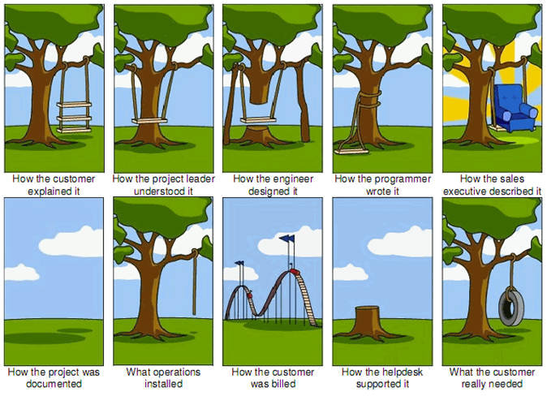
Project Management
Image: http://tamingdata.com/2010/07/08/the-project-management-tree-swing-cartoon-past-and-present/
CS/IT 490 WD, Fall 2013

Slide 2
Breakdown
Why Project Management is Important
Team Expectations
Software Development Methodologies
  Waterfall
  Spiral
  Agile
Group Project Milestones

Slide 3
Why Project Management is Important
Weeks of programming can save you hours of planning. -- unknown
Project Management is important in companies that build software, as with any other type of company.
Need to be able to figure out resources needed (time, money, manpower) & make deals on when a product will be done.

Slide 4
Why Project Management is Important
Organization is important to keep everybody on the same page.
  What are you working on?
  What am I working on?
  How much time do we have?
  What does the customer expect?
  What are the known bugs to be fixed?

Slide 5
Why Project Management is Important
BitBucket (our Source Control hosting solution this semester) has an Issues Tracking feature on the webpage.
  You can use this as a To-Do list and bug tracking list, to sync tasks between teammates.

Slide 6
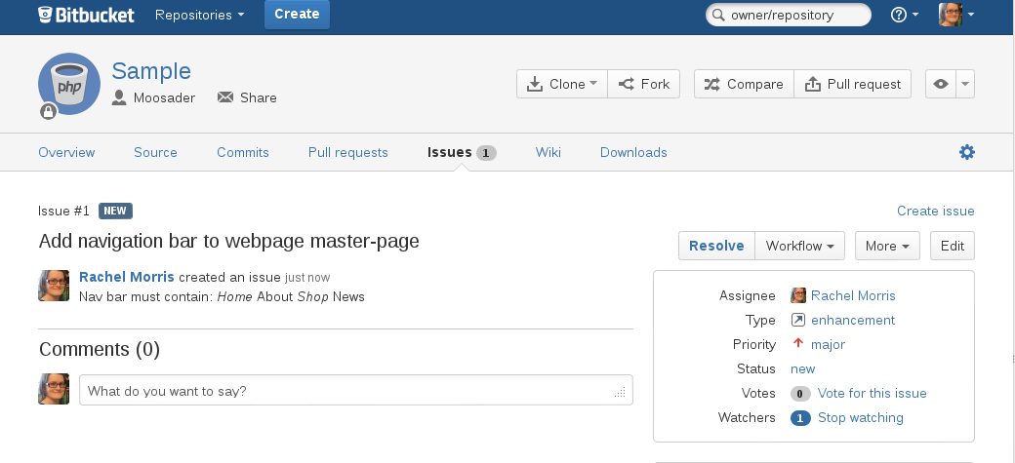
Why Project Management is Important
BitBucket

Slide 7
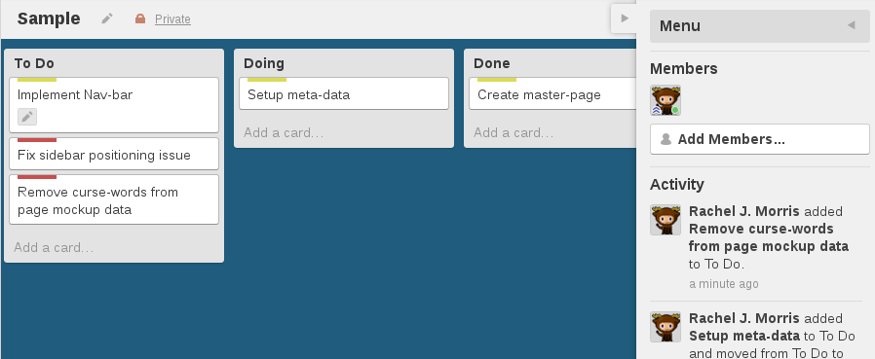
Why Project Management is Important
Alternatively, you can use Trello to organize tasks between teammates

Slide 8
Why Project Management is Important
Use one or the other for a project “To-Do”
Once you're in teams, choose which one you would prefer; I'll be setting up the repositories and tracking tools.
Please make sure to keep the tracking data up-to-date and make sure to assign tasks.

Slide 9
Team Expectations
Everybody does everything.
  Nobody is just a “tester” or “royalty-free-artwork procurement technician”
  Nobody is just the “CSS guy” or “Database lady”
  Everybody should work on HTML, CSS, JavaScript, PHP, and MySQL – work should be split up
  Everybody is responsible for filling out a postmortem at the end of every sprint

Slide 10
Team Expectations
Project code will be pushed to the repository by the Milestone due-dates
  We will talk about how to do this later.
If there is a problem with BitBucket or Git or any other tools, let me know as soon as possible.
  There is a grace-period of one day on assignment turn-ins, but you have to let me know you're running into trouble.

Slide 11
Team Expectations
Small Teams
  Preferably two people to a team –
  three at maximum
  Once you get more than that, it's hard to split up the work and coordinate appropriately

Slide 12
Team Expectations
Make something awesome
  This isn't a required class, so hopefully you're taking it because you have something in mind you want to make.
  Do something awesome.

Slide 13
Software Development Methodologies
Waterfall
Spiral
Agile
I want teams to think about software development as they work on their projects

Slide 14
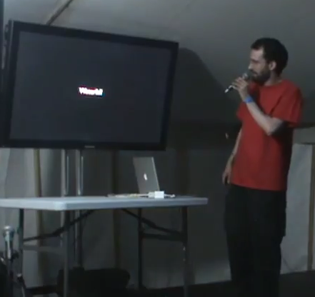
Software Development Methodologies
Waterfall
"Who read the original paper on Waterfall? Waterfall was a straw-man argument. On the first page of the paper, it went ‘Here is a system that doesn’t work.’
But it turns out when you put a really nice picture of the front page of your paper, that’s as much as people will read.”
[What is waterfall?]
"Waterfall is .. Have you ever seen the cartoon with the birds in a tree. The birds at the bottom of the tree get covered in shit, and when they look up all they see is assholes."
"It turns out that we don’t need to worry about risk management, we don’t need to worry about slack, because we’ll just make the programmers work 80 hours a week. That’s all they’re good for."
From “Programming is terrible—Lessons learned from a life wasted. EMF201” by Thomas Figg
http://youtu.be/csyL9EC0S0c?t=14m59s

Slide 15
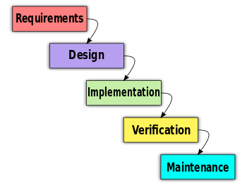
Software Development Methodologies
Waterfall
A generally bad development methodology
Try to figure out all of the requirements at the beginning
Implement everything all at once
Verify and hope everything worked as planned
Waterfall image from https://en.wikipedia.org/wiki/File:Waterfall_model_%281%29.svg

Slide 16
Software Development Methodologies
Waterfall
When does anything go according to plan?
See also: Murphy's Law

Slide 17
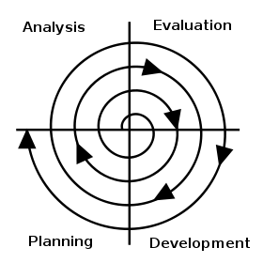
Software Development Methodologies
Spiral
It's better to review and
reorient the project often
Solve development issues
as soon as possible
Feedback from customers
often
Like when you drive a car; you don't just aim at your goal and hit the gas, you are constantly adjusting your direction
Spiral image from https://en.wikipedia.org/wiki/File:Software_Development_Spiral.svg

Slide 18
Software Development Methodologies
Agile
Iterative and incremental: The software evolves over time.
Set of values:
  Individuals and interactions over processes and tools
  Working software over comprehensive documentation
  Customer collaboration over contract negotiation
  Responding to change over following a plan
https://en.wikipedia.org/wiki/Agile_software_development

Slide 19
Software Development Methodologies
Agile
SCRUM is a type of Agile development
What is SCRUM? (5 minutes)
https://www.youtube.com/watch?v=niVbODz4Dnw
What is KANBAN? (6 minutes)
https://www.youtube.com/watch?v=0EIMxyFw9T8
Some companies follow “SCRUMBUT”
  i.e., they say they're Agile and follow SCRUM, but they pick-and-choose aspects
  "(We use Scrum, but) (Retrospectives are a waste of time,) (so we don't do them.)"
http://www.scrum.org/ScrumBut

Slide 20
Group Project Sprints
This probably qualifies as “SCRUMBUT” - oh well.
There will be four sprints this semester.
At the beginning of each sprint, teams will create a tentative plan and set up their task list (BitBucket, Trello)
At the end of each sprint, students will prepare a Postmortem, and gather some screenshots to show off to the class.

Slide 21
Group Project Sprints
At the end of the final sprint, teams can demo their live website to the class.
Make sure to save your project documentation and screenshots – they can go in your portfolio!

Slide 22
References
Cover image from http://tamingdata.com/2010/07/08/the-project-management-tree-swing-cartoon-past-and-present/
Programming is terrible—Lessons learned from a life wasted, Thomas Figg
http://youtu.be/csyL9EC0S0c?t=14m59s
Waterfall model, Wikipedia
https://en.wikipedia.org/wiki/Waterfall_model
Spiral development software development methodology, Wikipedia
https://en.wikipedia.org/wiki/Software_development_methodology#Spiral_development
Agile software development, Wikipedia
https://en.wikipedia.org/wiki/Agile_software_development
SCRUMBUT
http://www.scrum.org/ScrumBut

